Slide 1

BUILDING AN AI PIPELINE FOR IMAGE SEGMENTATION AND OBJECT ANALYSIS
A Comprehensive Approach for Detecting and Analyzing Objects in Images
V.Sriram

Slide 2
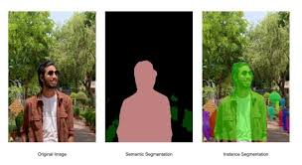
Introduction to AI Pipeline for Image Segmentation
Image segmentation involves partitioning an image into multiple segments to simplify analysis.
Object analysis focuses on identifying and classifying objects within segmented regions.
Combining these techniques enhances machine understanding of visual data, important for various applications.

Slide 3

STEPS OF PROJECT
Image Segmentation
Object Extraction and Storage
Object Identification
Text/Data Extraction from Objects
Output Generation and Testing with Streamlit UI
Summarize Object Attributes
Data Mapping

Slide 4
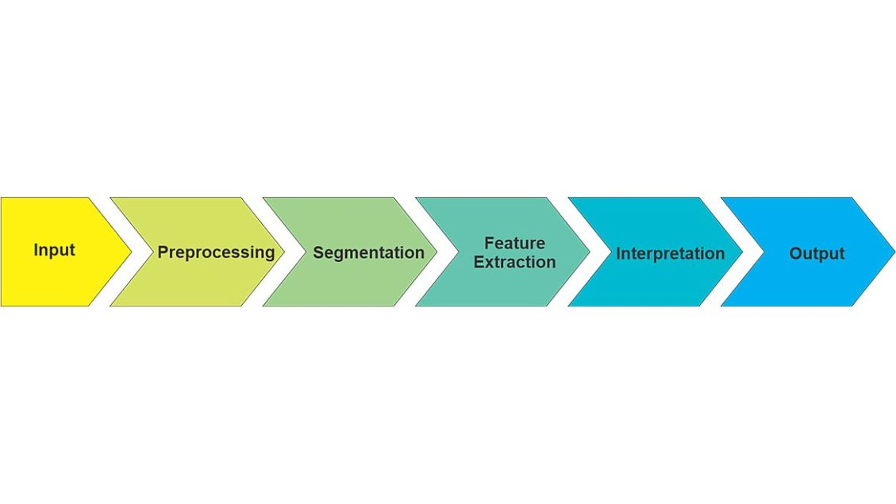
Data Collection and Preprocessing
Diverse Sources: Capture images from different sources to capture different object types and scenarios.
Annotations: The images should have pre-labeled segmentation masks and labels for the objects. This should be the case for the training.
Ethical Practices: Ensure privacy, consent, and legal standards concerning data collection.
Standardization of Images: Resize and normalize images to feed consistently into the pipeline.
Data Augmentation: Training data augmented by rotation, flipping, and changes in color in the image.
Noise handling involves cleaning and filtering out the noisy or incomplete data to uphold the quality of the data.

Slide 5
Model Selection and Training
Utilization of Pre-trained Models: Pre-trained models such as Mask R-CNN DeepLabV3 and YOLOv5 are used in this pipeline. They work efficiently for the tasks of picture segmentation and recognition of objects. The existing models were selected because they are known to be precise and give good results when faced with complicated pillage images. Tweaking for Specific Tasks: For each model, the team tailored them to make them better on the specific dat set them worked with as well as the task that needed tackling in the first place. This includes changing layers plus parameters to achieve segmentation accuracy and increase the precision when detecting objects. Testing and Improving: The pipeline tested throughout training-time so as to ensure that the models were robust enough and they could respond well to new data types. A method was also utilised in improving settings that would try balancing speed against accuracy.

Slide 6
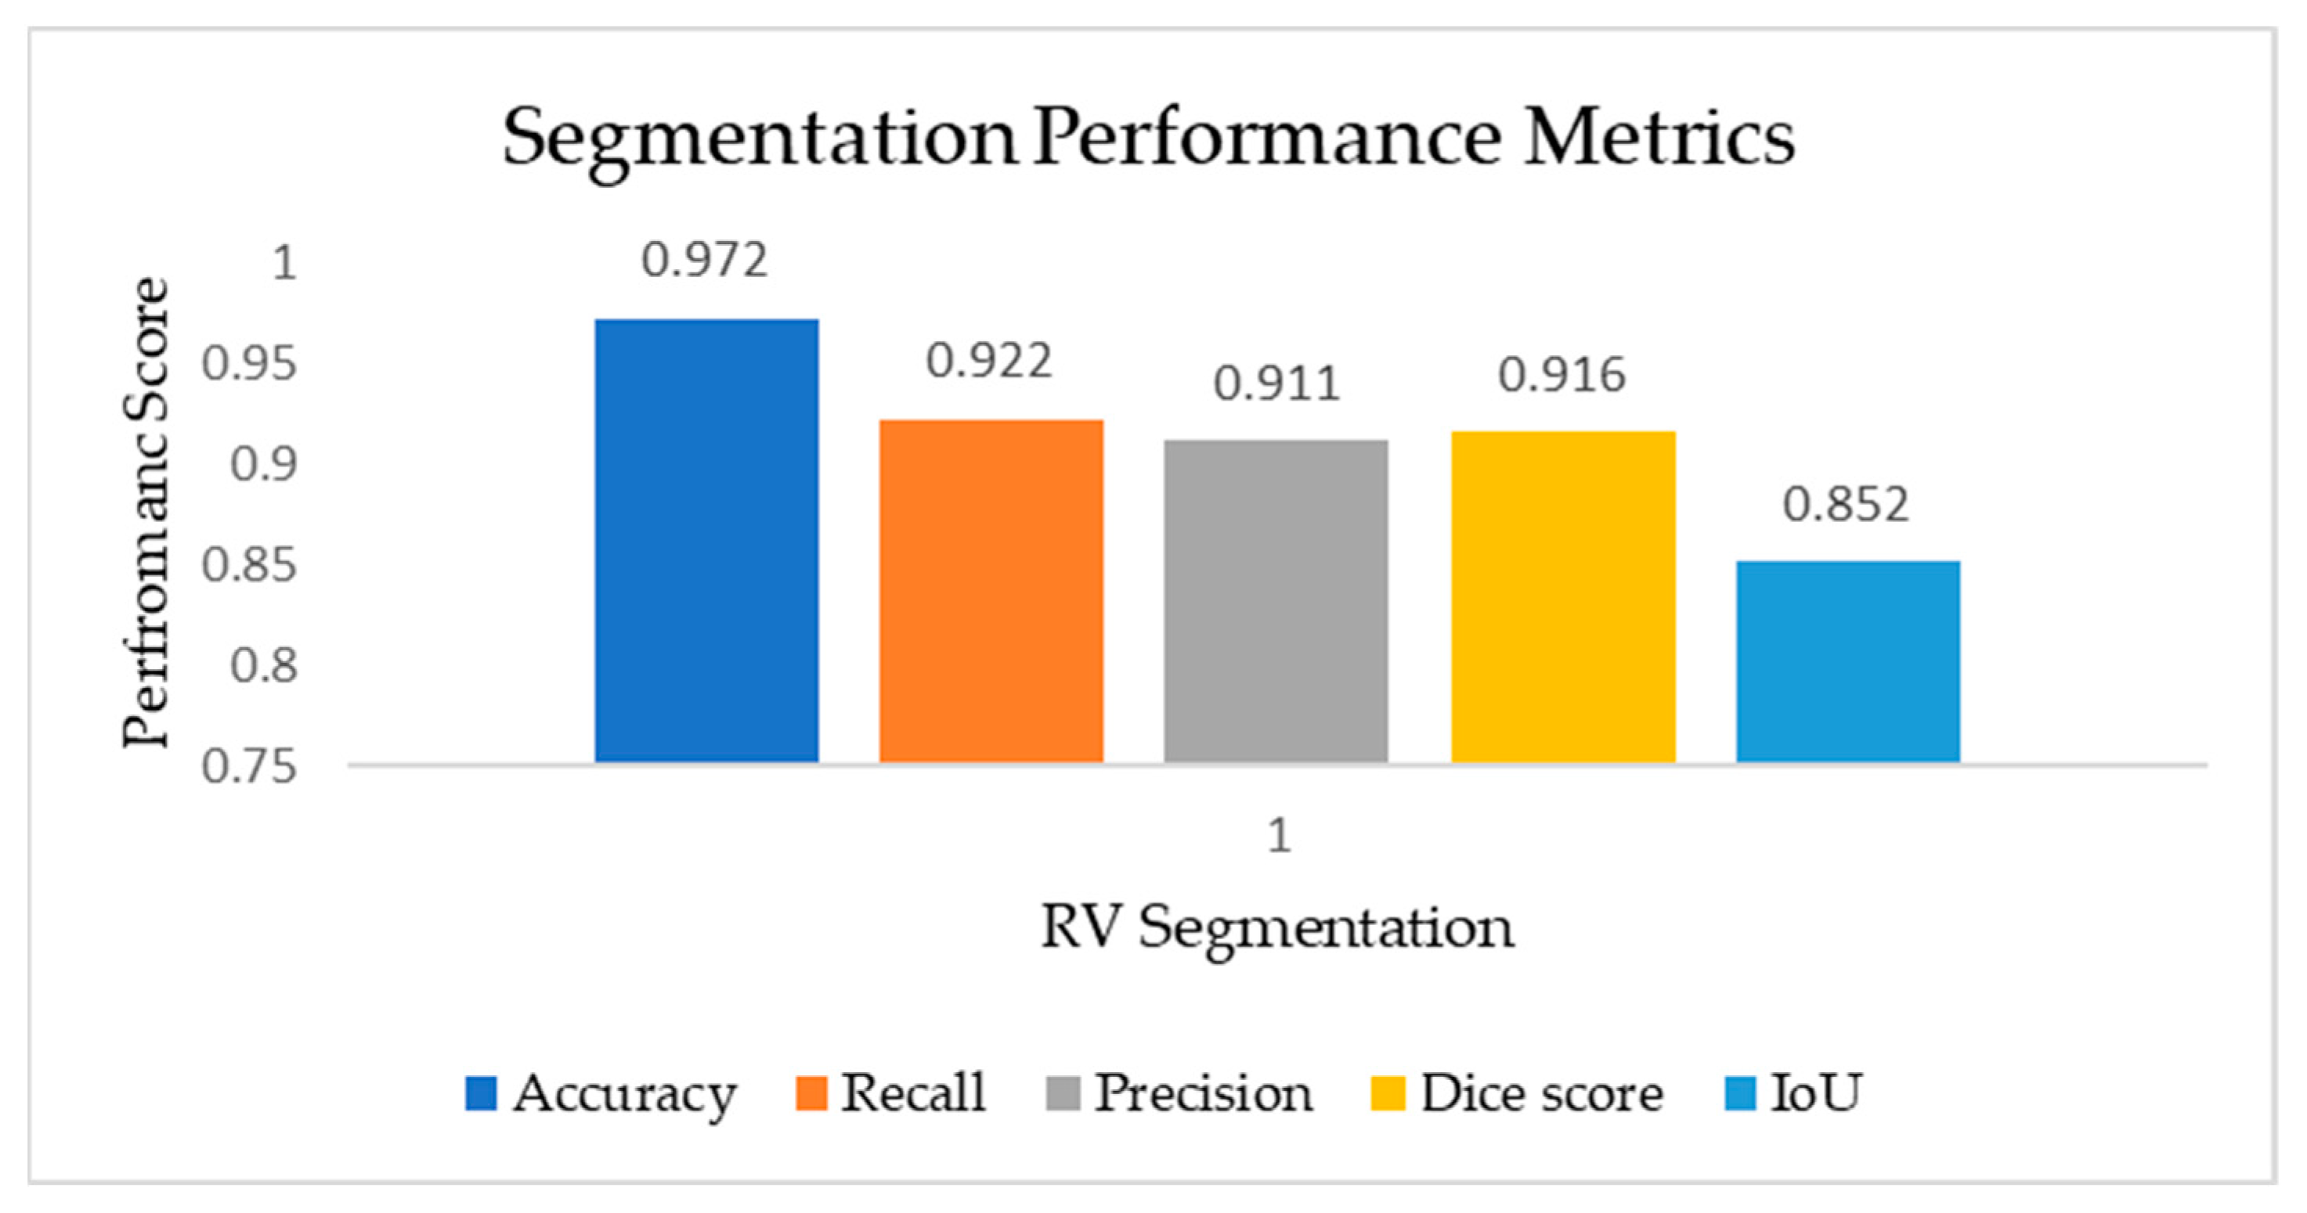
Evaluation Metrics for Performance
Accuracy and Precision: The evaluation of object detection and segmentation accuracies was done using Intersection over Union (IoU) measurements between predicted and ground truth masks. The precision and recall metrics were also calculated in order to evaluate the pipeline’s ability to correctly identify and segment objects.
Execution Speed: Processing time per image served as an indicator on how well this pipeline performed in regard to real-time operations by making sure that all models work at their best possible efficiency levels. This involved evaluating the individual inference times for each model (Mask R-CNN, DeepLabV3, YOLOv5) and overall speed of the entire pipeline from start to finish, in order for it to be able to operate with real-time requirements.
Robustness and Generalization: To check for robustness of the pipeline different images having various degree of complexities were tested. These models were made sure to have good generalization in different scenes or object types through assessing their balance between precision and recall using metrics like F1-score or confusion matrix.

Slide 7
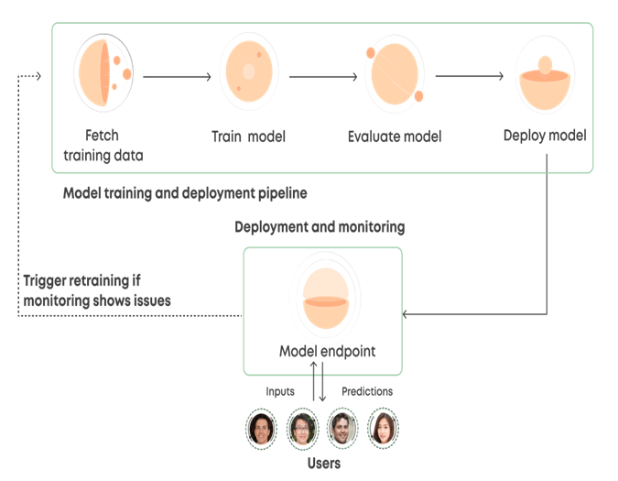
Deployment Strategies
Web Application with Streamlit:
A user-friendly web interface can be developed using Streamlit, allowing end-users to interact with the pipeline through their browsers. This approach is ideal for testing, showcasing, and deploying the pipeline with minimal overhead. The application can be hosted on platforms like Heroku or through cloud services to make it accessible to users globally.

Slide 8
Future Directions and Challenges
Boosting Precision in Models: Make adjustments to models utilizing more spacious and diverse datasets so as to increase their abilities of efficient segmentation along with object detection.
Immediate Processing: Improve pipeline for quicker processing in order to facilitate real-time applications such as those found in self-governing systems.
Dealing with Complex Photographs: Tackle hurdles associated with separating and interpreting overlapping or very complex items for the sake of making stronger ones.

Slide 9

Thank You

